Slide 1

Cyclistic Customer Behavior
How Does a Bike-Share Navigate Speedy Success?
Case Study by Elias Mengesha
Last updated Apr 14, 2023

Slide 2
Business goal
“Design marketing strategies aimed at converting casual riders into annual members”

Slide 3
How do annual members and casual riders use Cyclistic bikes differently?

Slide 4
Findings & Insights

Slide 5
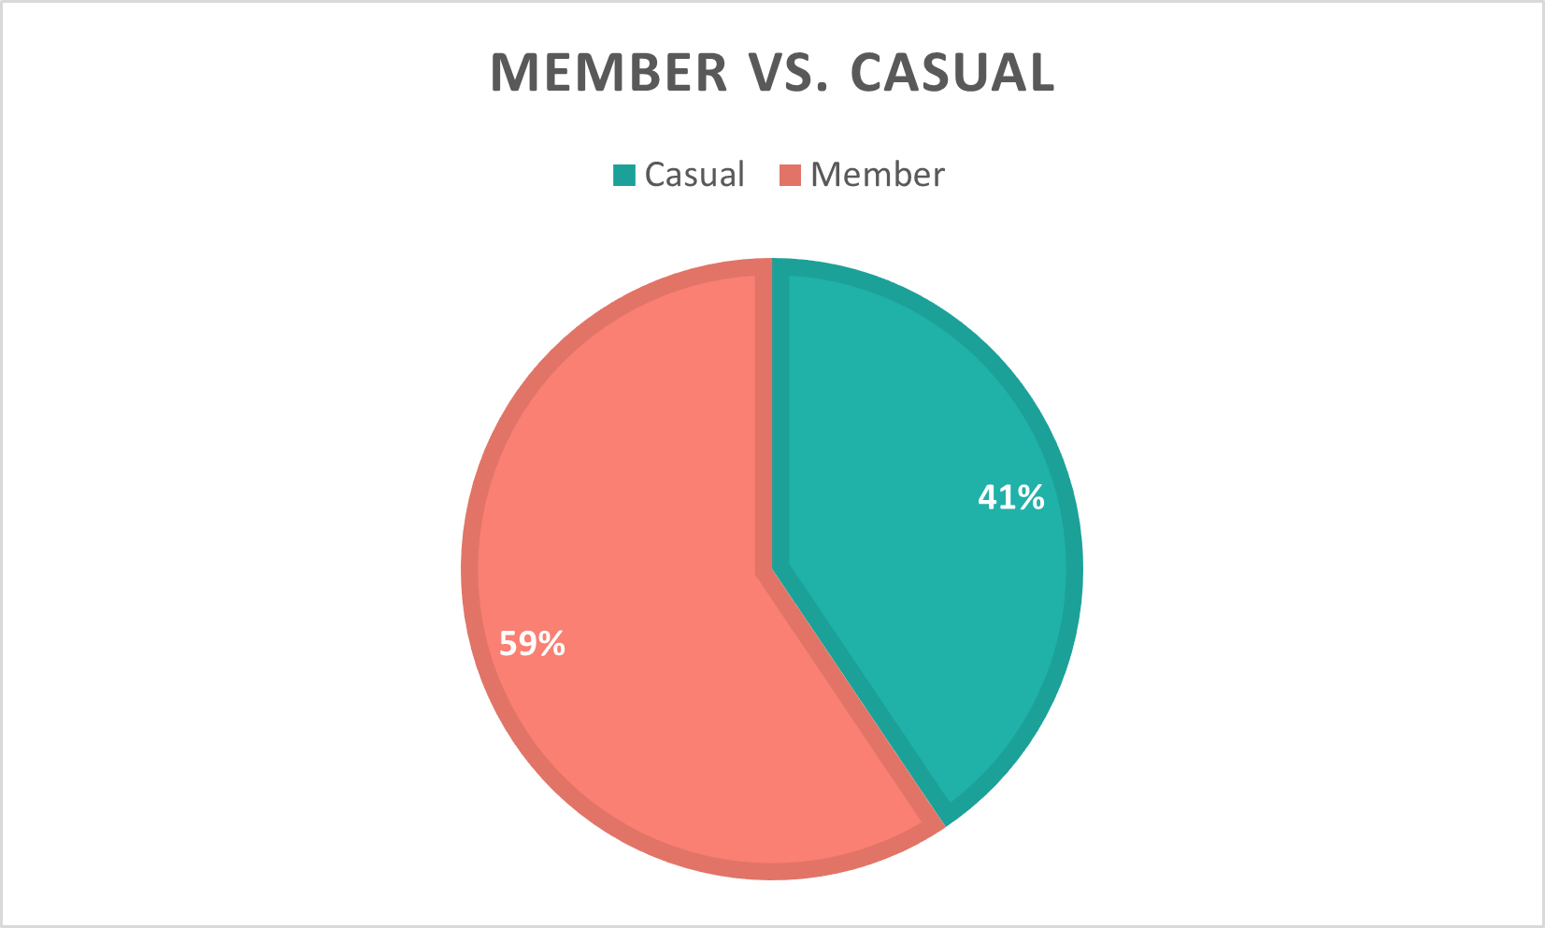
What is the percentage of each user type?

Slide 6
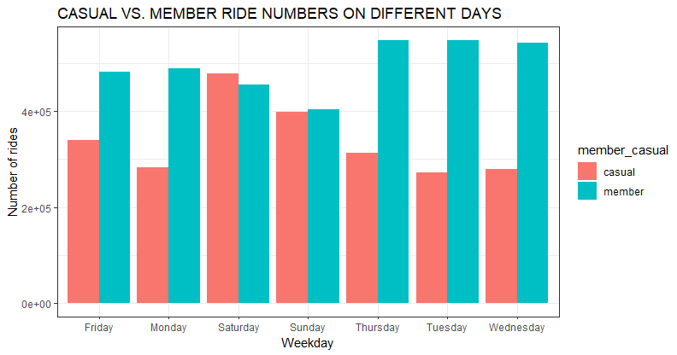
2. How do they use Cyclistic on different days?
Members dominate in the weekdays.
On weekends, There is a surge of casual users which came close (pass, on saturday) to the member’s number.

Slide 7
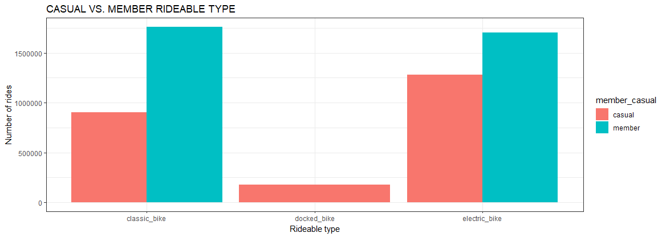
3. How do their rideables differ?
Docked bikes are exclusively used by casual riders.
The number of members who use classic bikes are almost double of the casual riders.

Slide 8
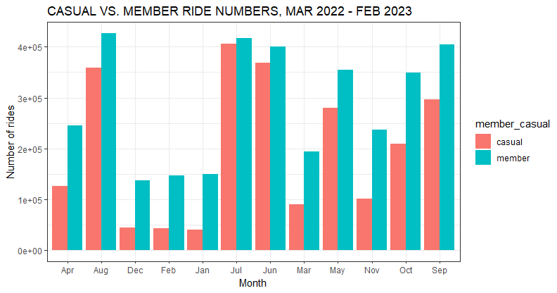
4. Their difference throughout the year?
Members dominate throughout the year, yet we a surge of casual users in the months June, July, and August.

Slide 9
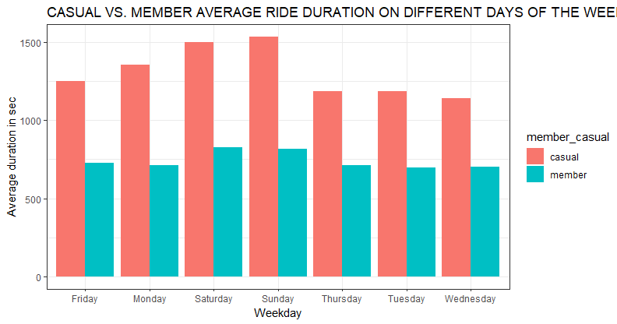
5. How does their average trip duration vary?
Strangely, the average trip duration throughout the weekday shows that casual members have the higher position. This suggests that the casual members take longer trips.

Slide 10
Recommendations

Slide 11
Top 3 actions to take
Try to reach the casual members on the weekends, since they are most active during that time.
Increase the variety of docked bikes.
Plan a summer marketing campaign to attract the surge of casual users that come during that period.

Slide 12
Thank you!

